Slide 1
EDA PRESENTATION BY GROUP : 1 Mr.Mullagiri Pavan RohithGandhi Miss.Boddam Sathvika Mr.Nikhil Vilas Patil Mr.Jayesh Kuwar Mrs.Shraddha Jadhav Mr.Karan Kalange

Slide 2
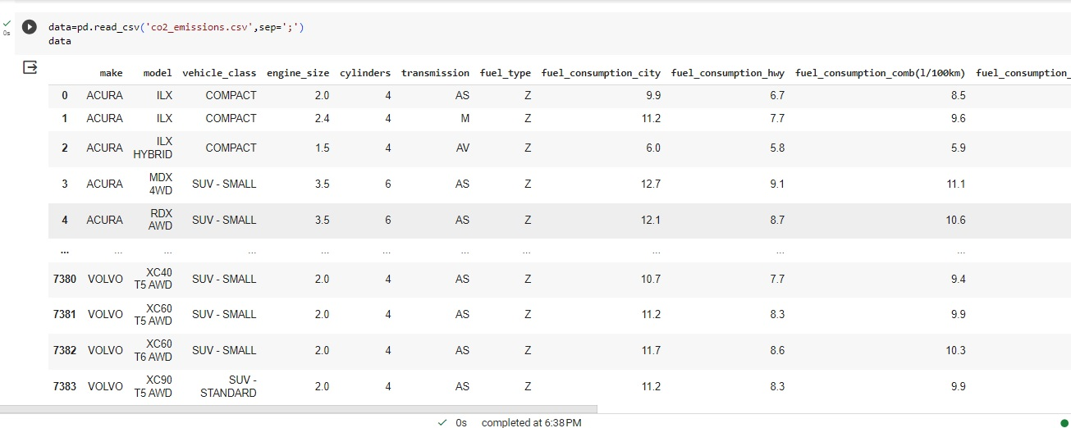
IMPORTING DATASET

Slide 3
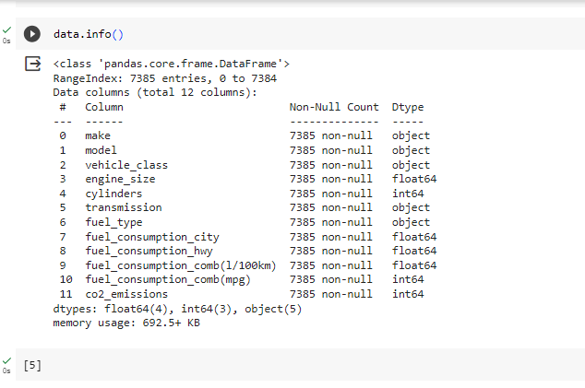
FETCHING INFORMATION FROM DATASET

Slide 4
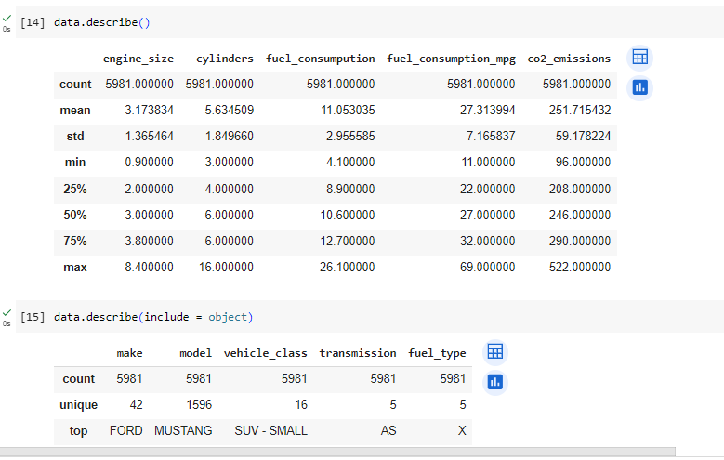
DESCRIBING THE NUMERICAL DATA AND CATEGORICAL DATA.

Slide 5
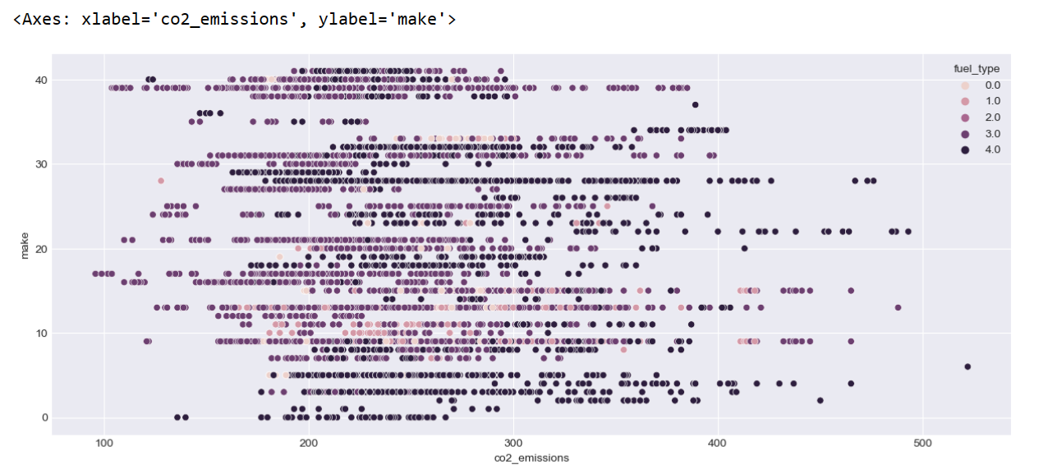
COMPARISON BETWEEN CO2_EMISSION AND MAKE.

Slide 6
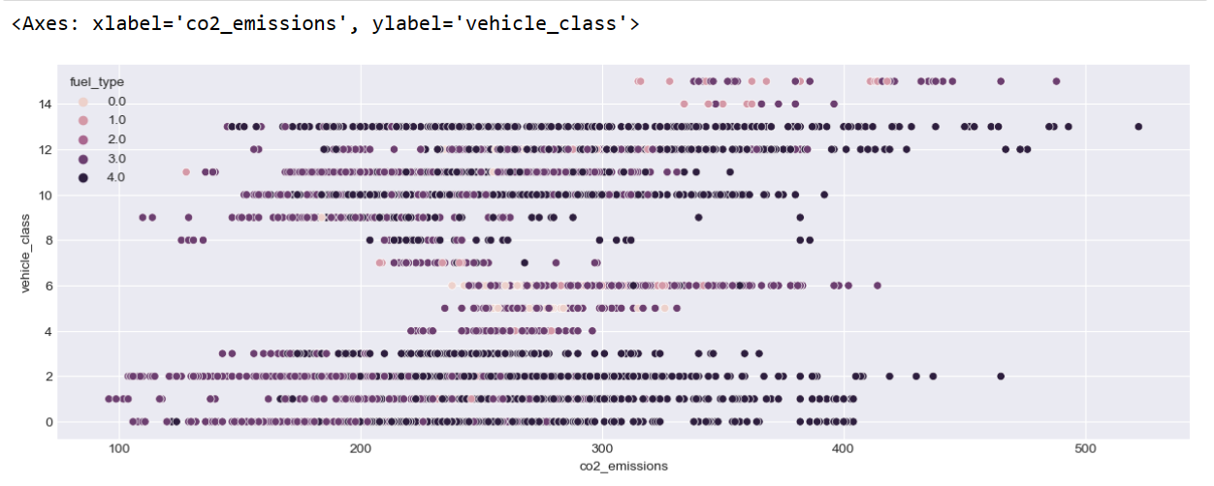
COMPARISON BETWEEN CO2_EMISSION AND VEHICLE_CLASS.

Slide 7
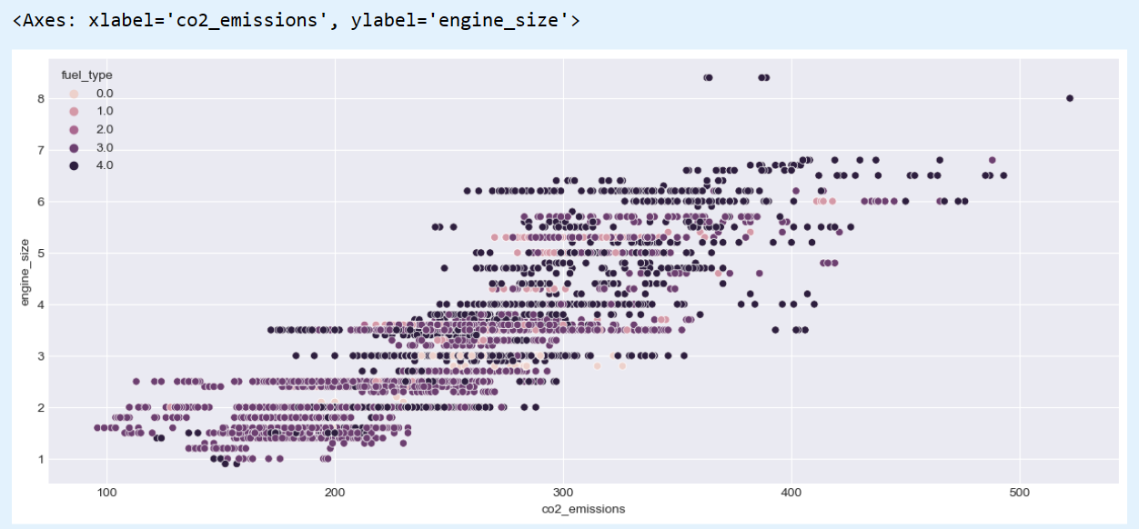
COMPARISON BETWEEN CO2_EMISSION AND ENGINE_SIZE.

Slide 8
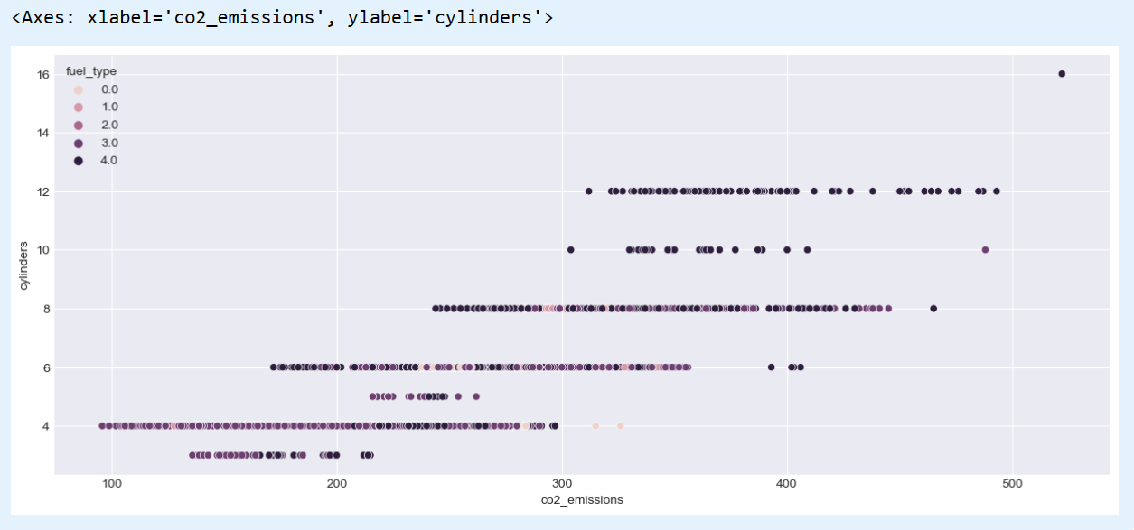
COMPARISON BETWEEN CO2_EMISSION AND CYLINDERS.

Slide 9
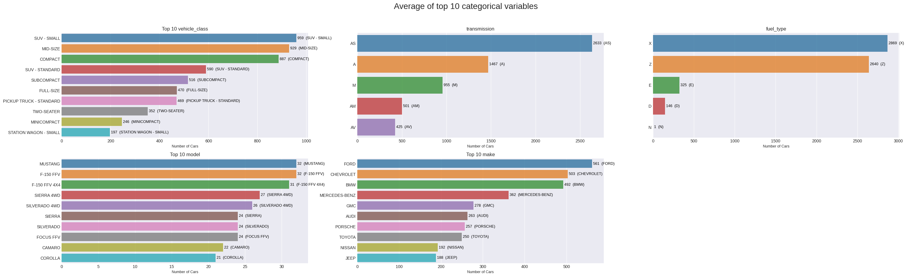
AVERAGE OF TOP 10 CATEGORICAL VARIABLES.

Slide 10
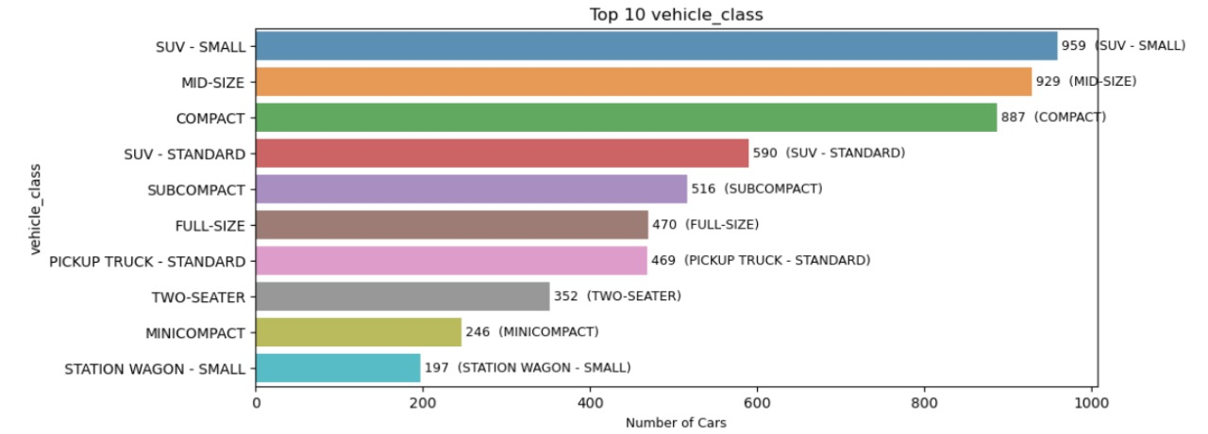

Slide 11
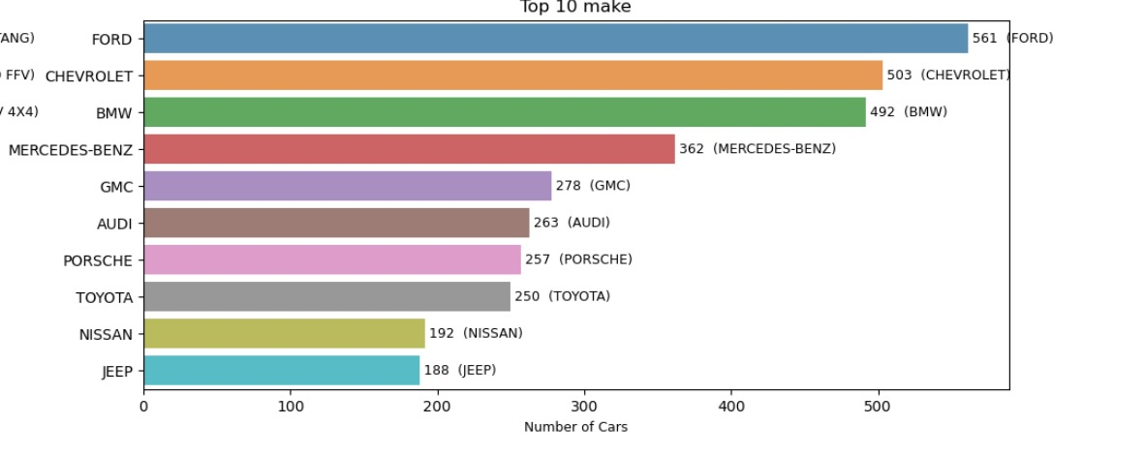

Slide 12
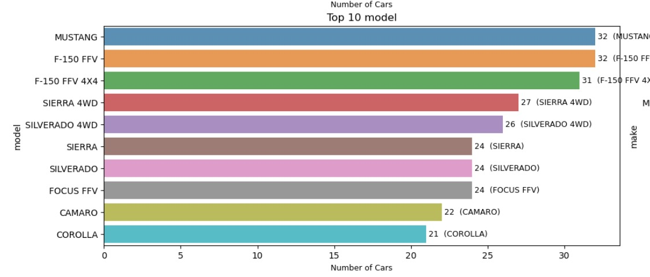

Slide 13
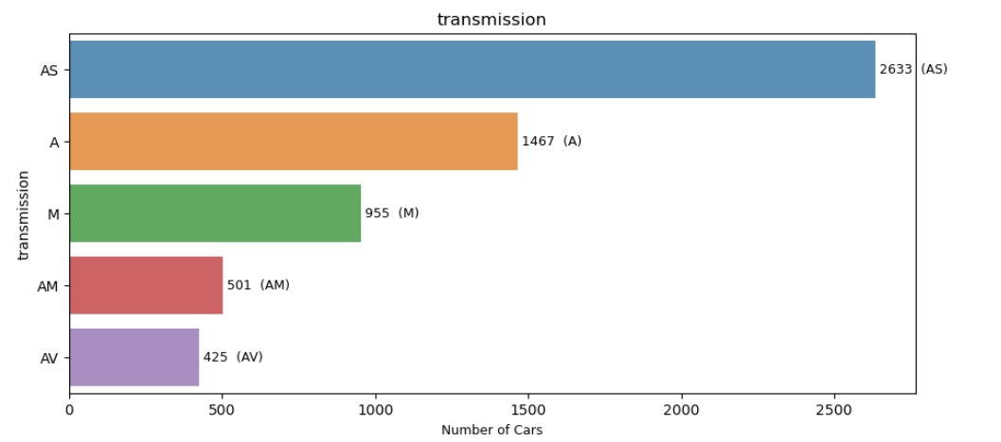

Slide 14
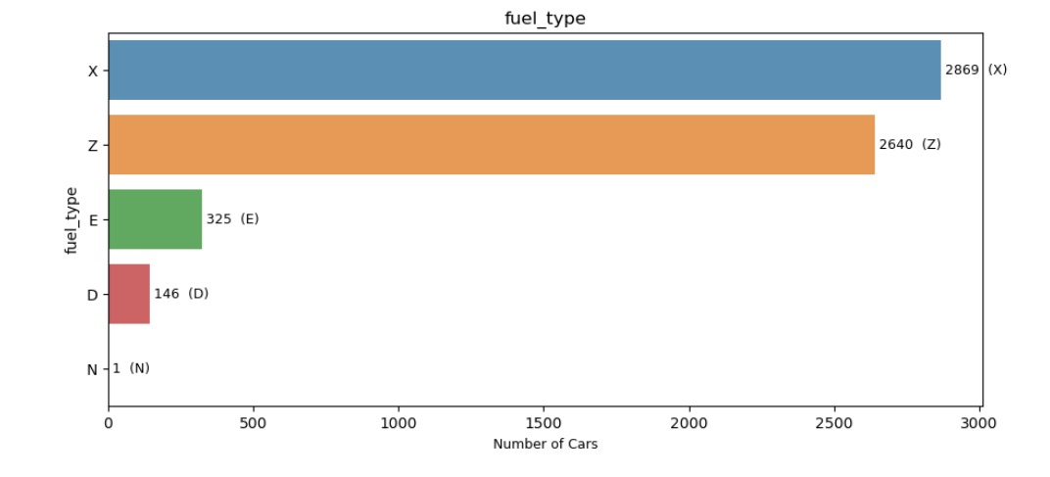

Slide 15
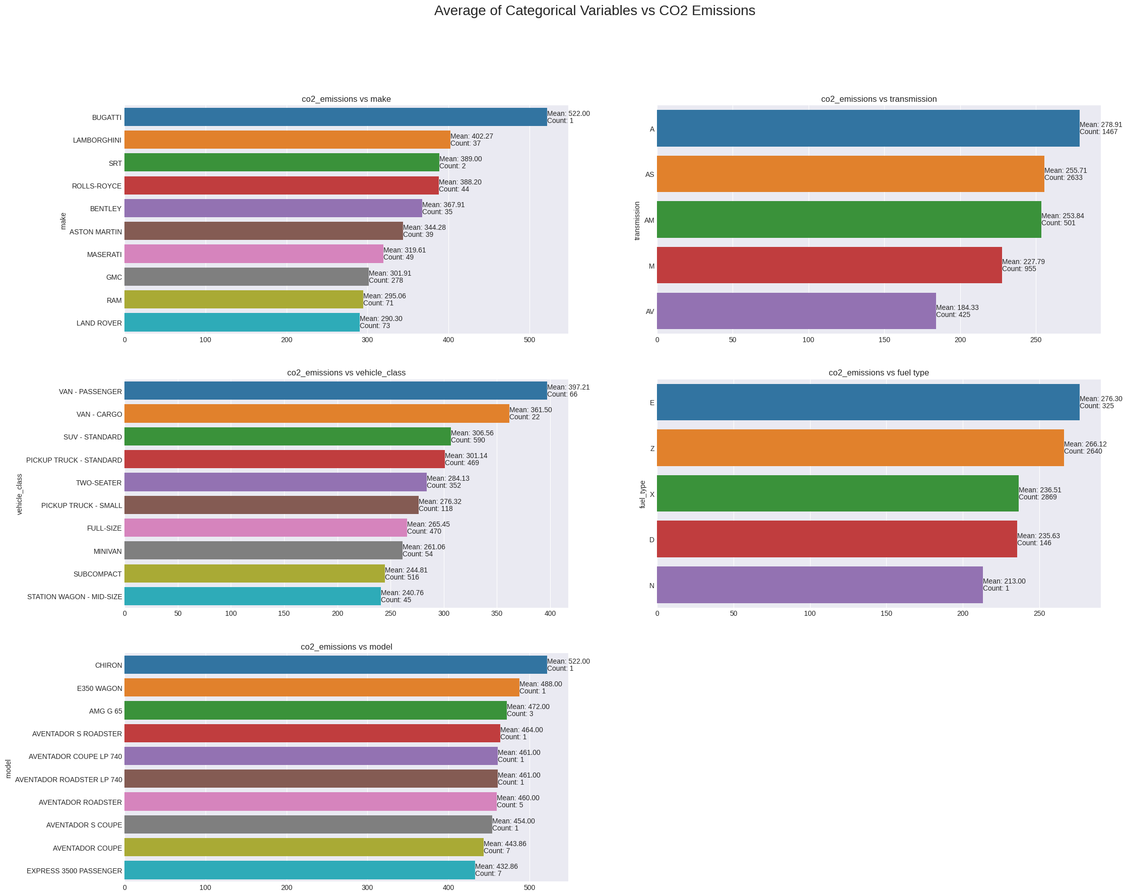
Average of Categorical Variables VS Co2 Emission.

Slide 16
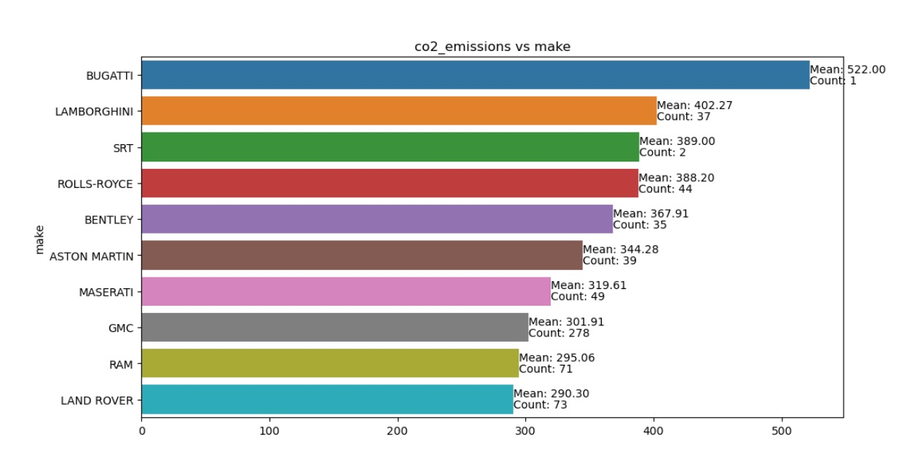

Slide 17
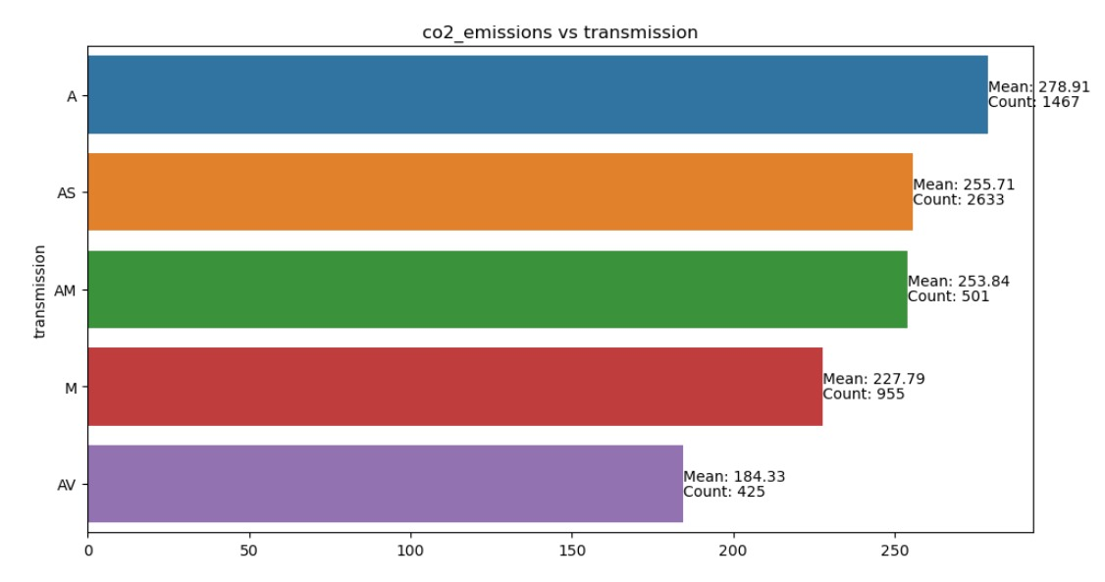

Slide 18
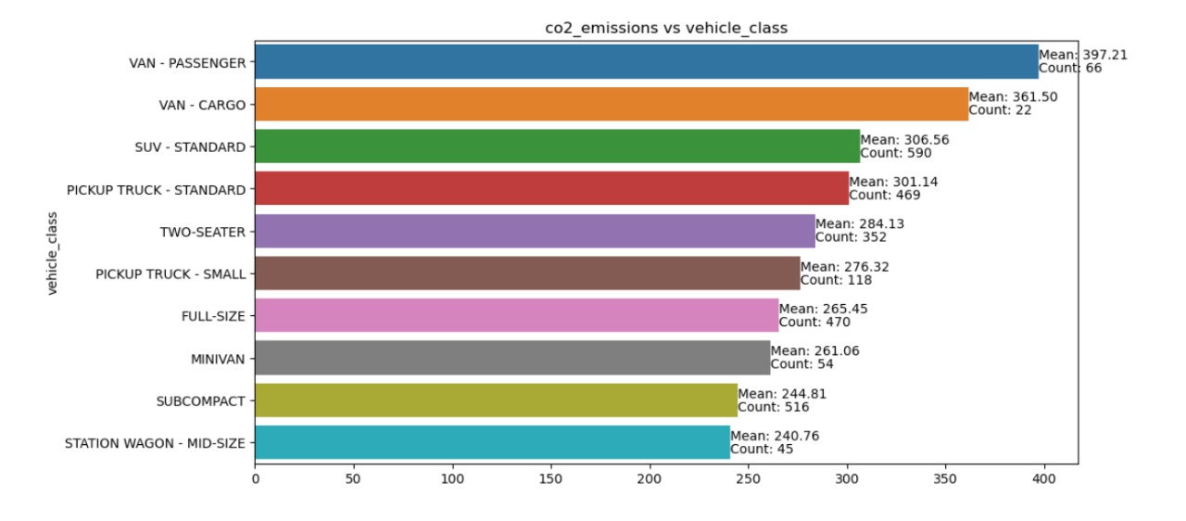

Slide 19
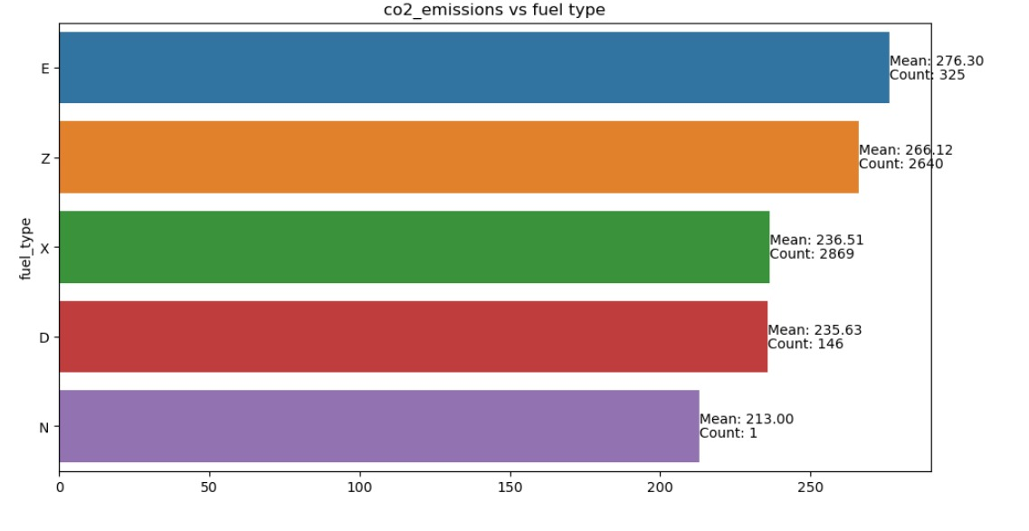

Slide 20
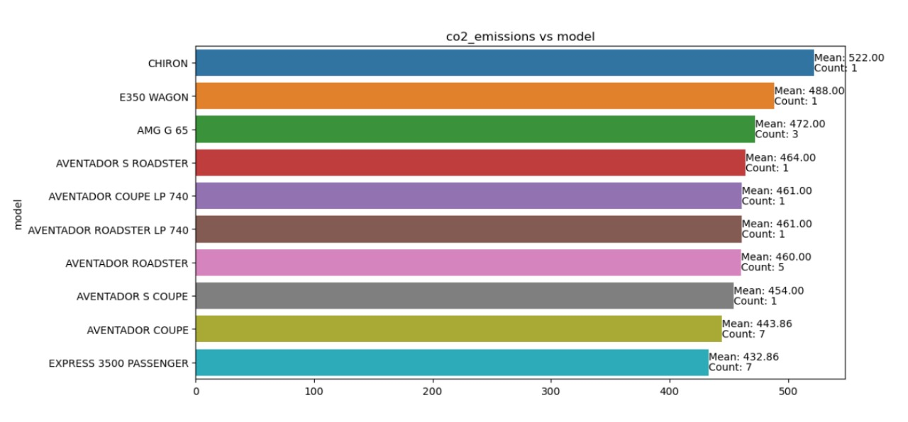

Slide 21
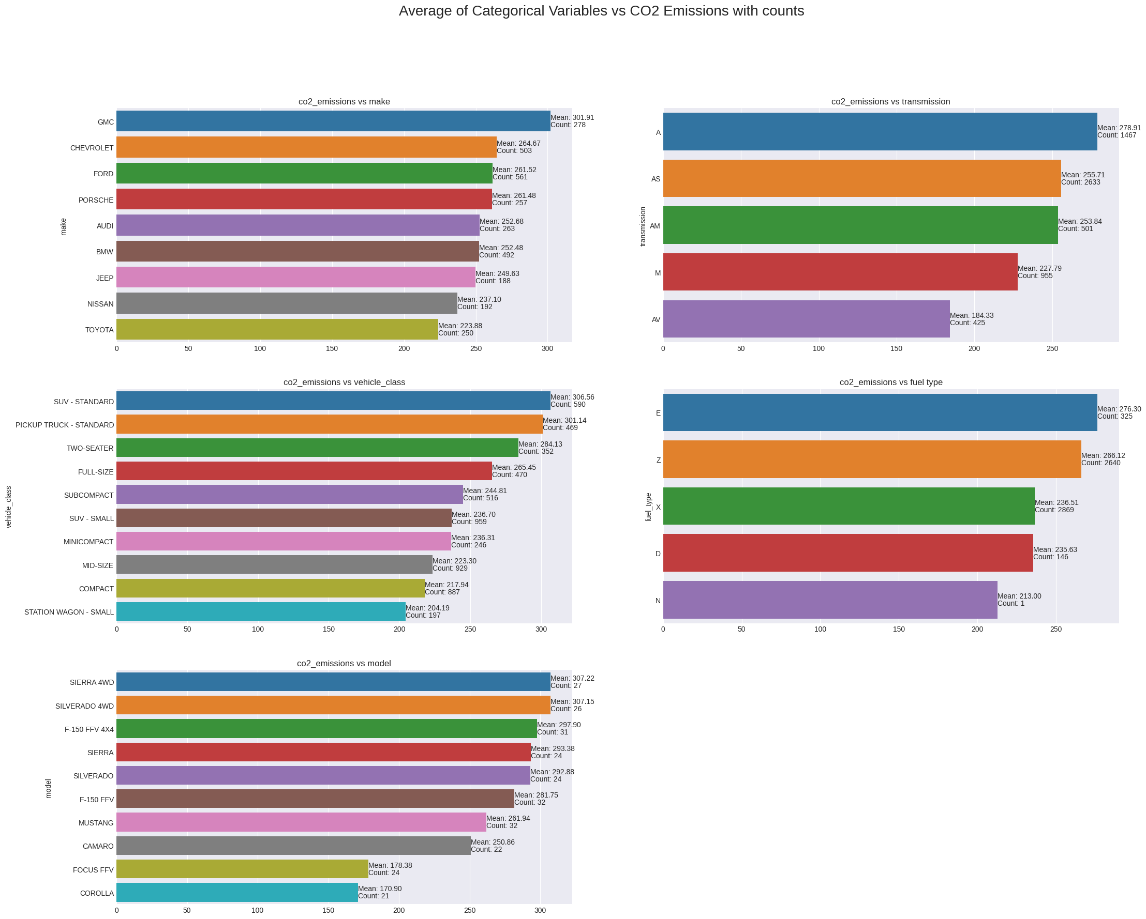
Average of Top 10 Category Variables VS Co2_Emission

Slide 22
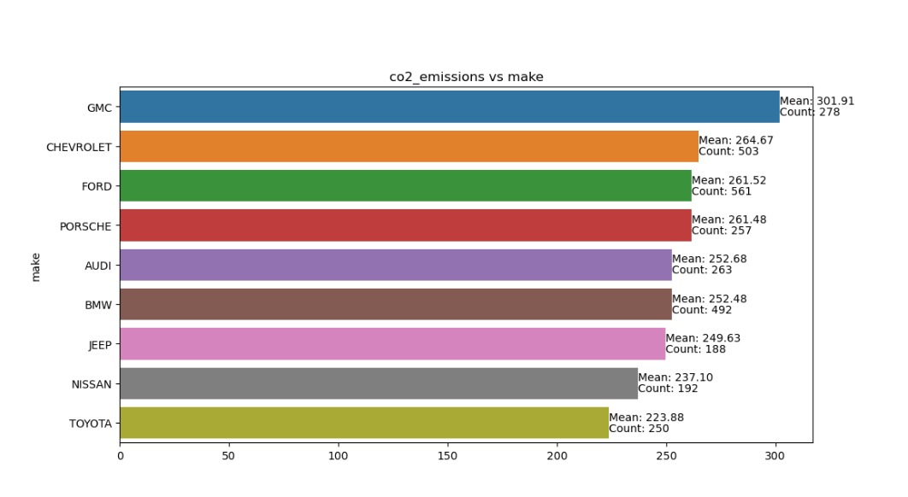

Slide 23
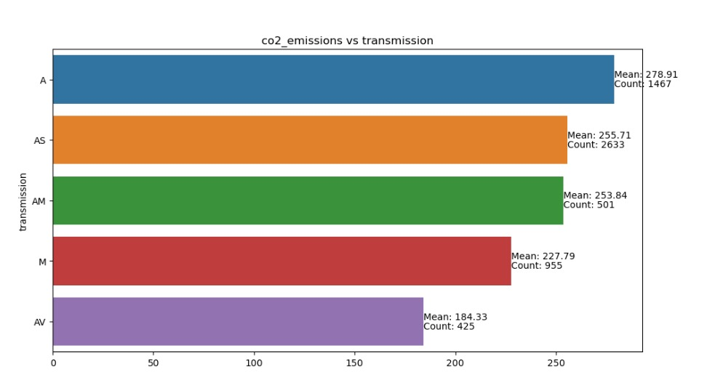

Slide 24
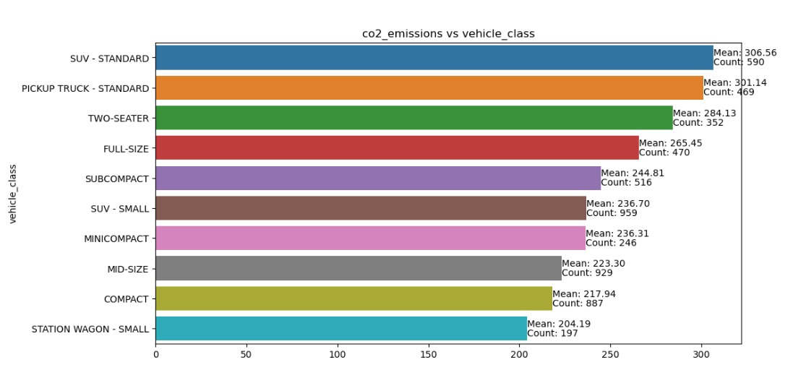

Slide 25
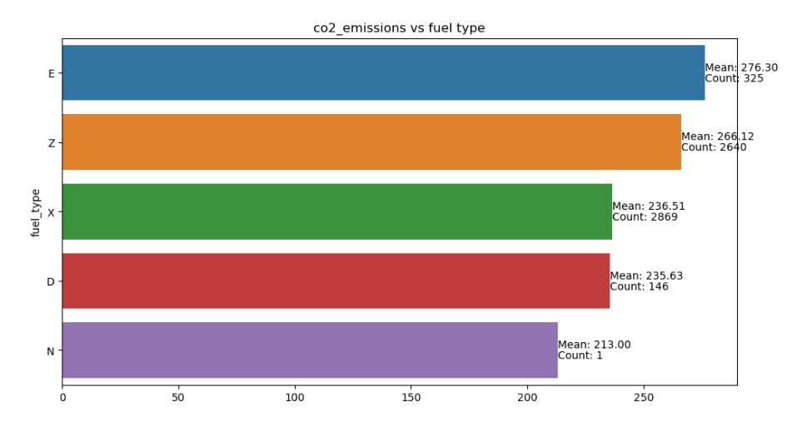

Slide 26
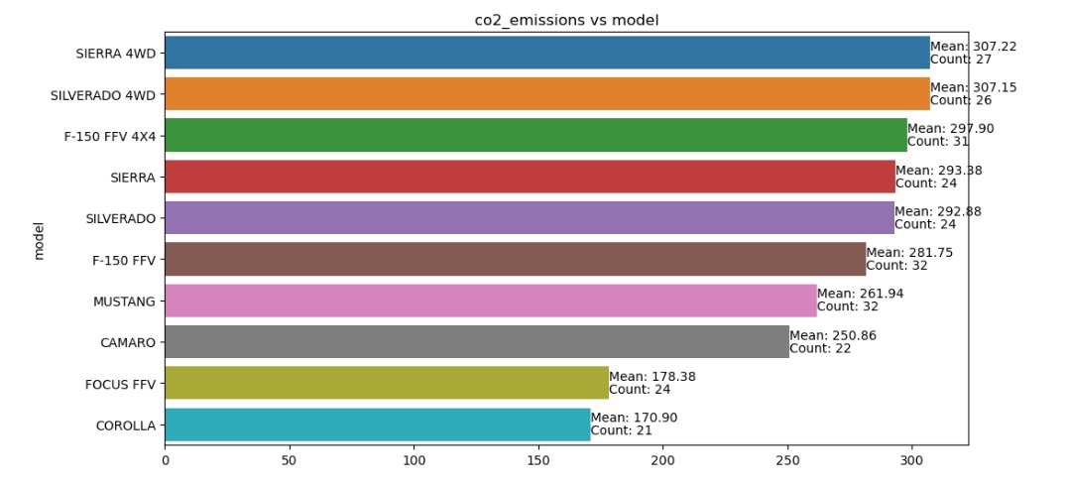

Slide 27
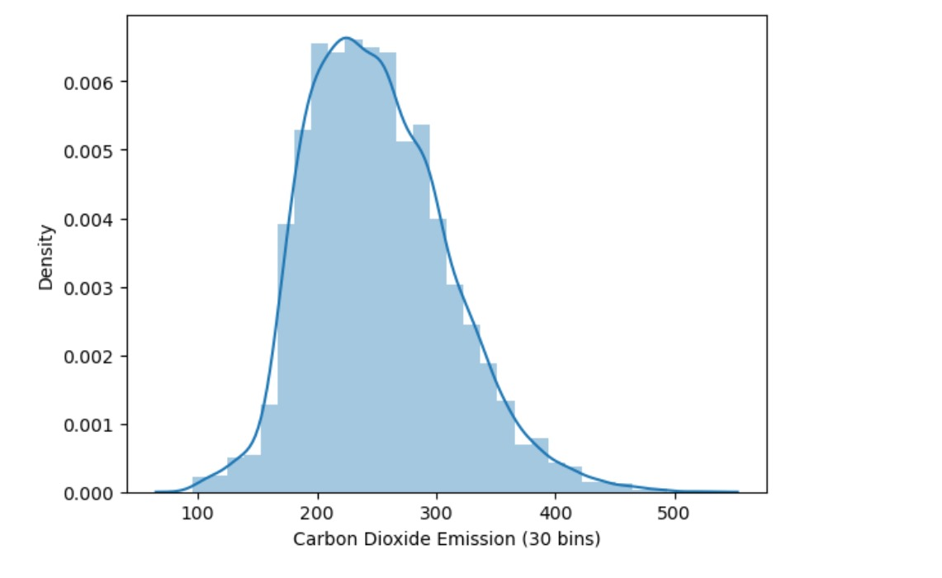
SKEW OF THE CO2 EMISSION.

Slide 28
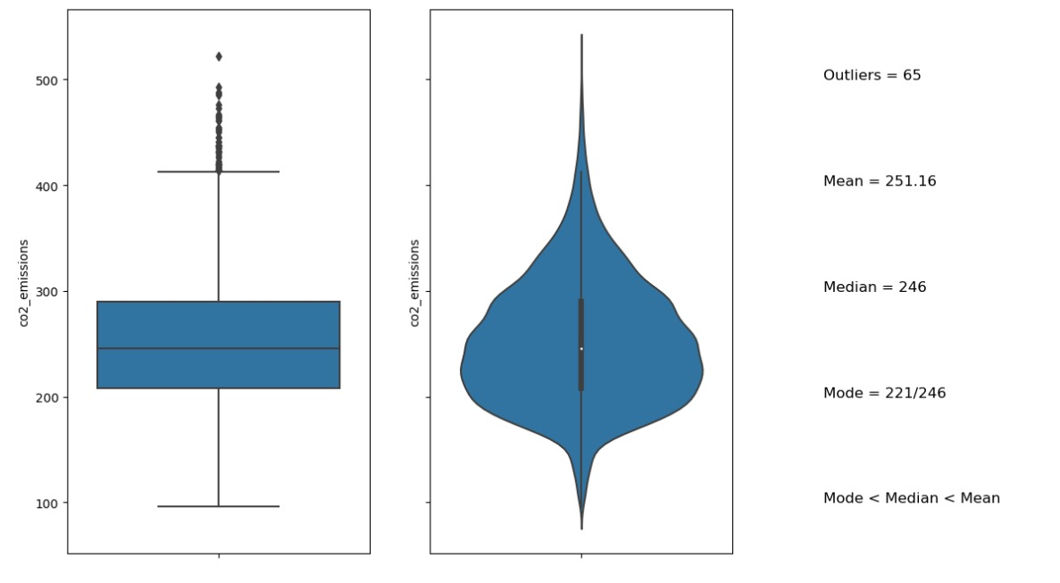
OUTLIERS ON CO2_EMISSION.

Slide 29
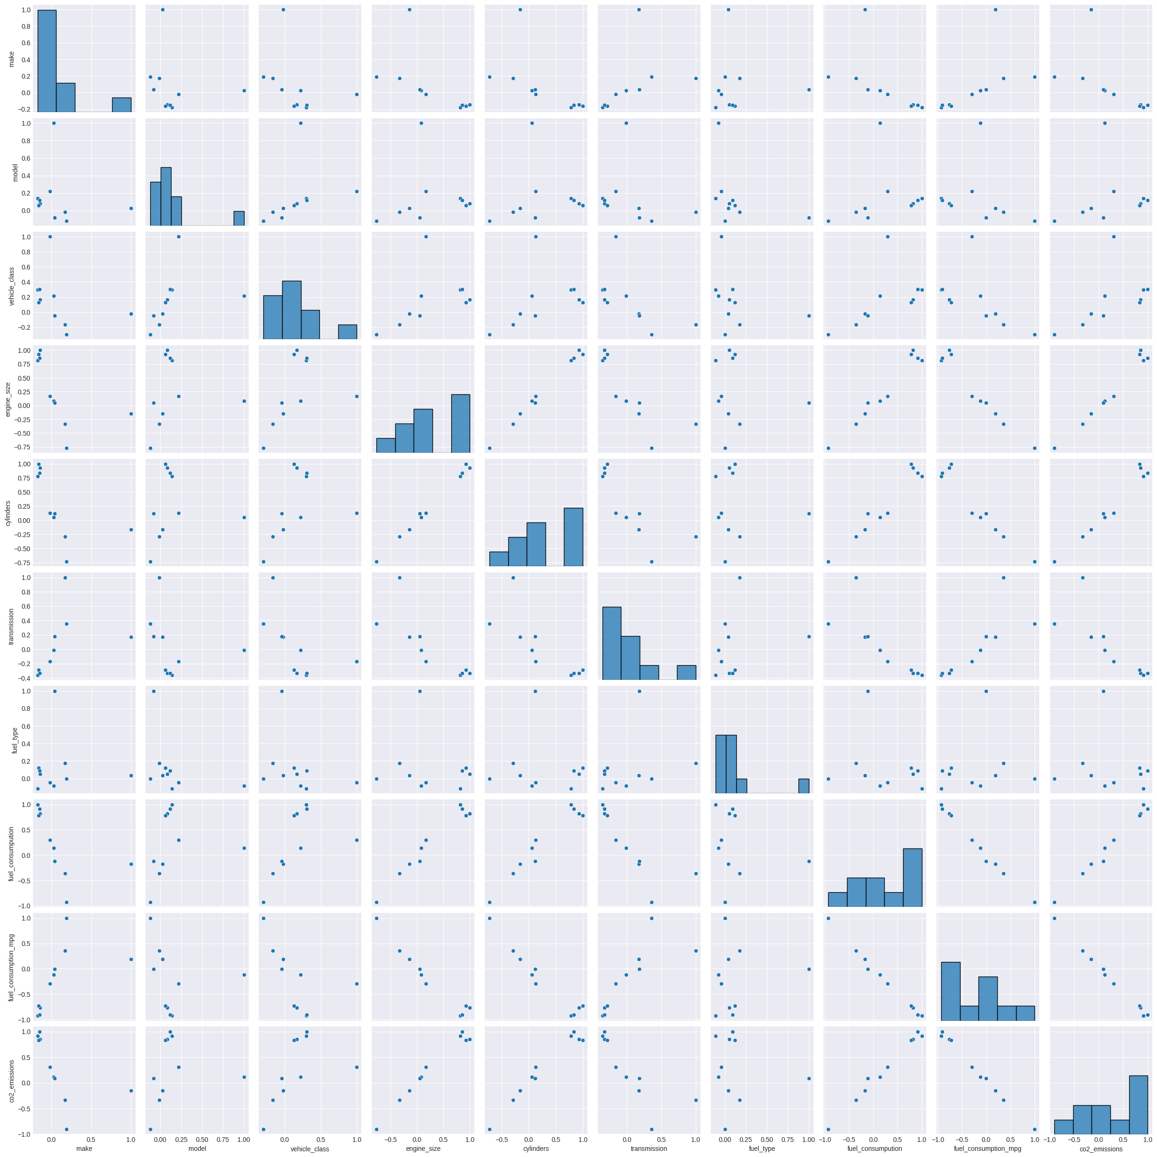
CORRELATION OF THE DATASET.

Slide 30
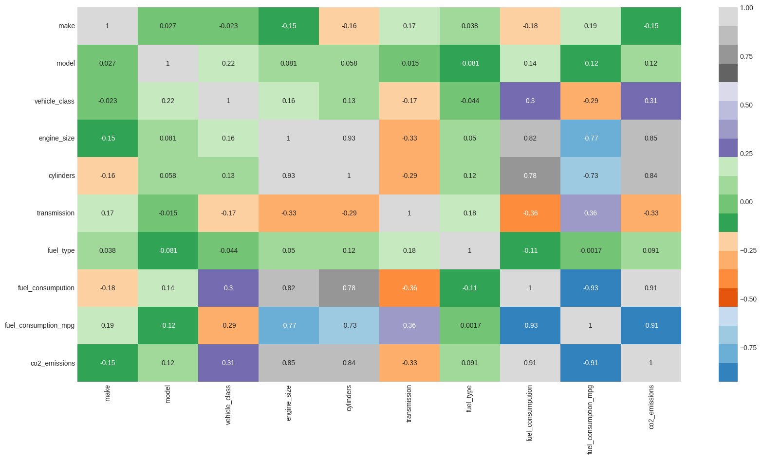
HEATMAP

Slide 31
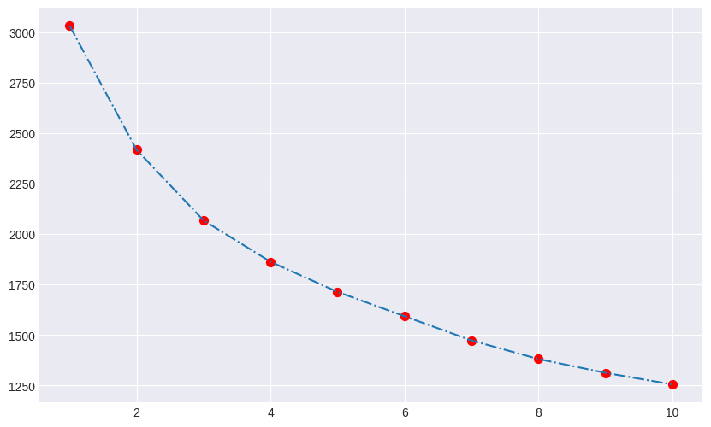
CLUSTERING ON ELBOW METHOD.

Slide 32
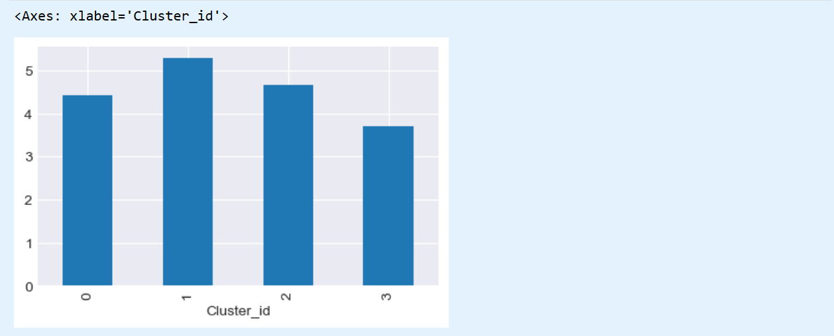
COMPARISON BETWEEN CO2_EMISSION AND CLUSTER.

Slide 33
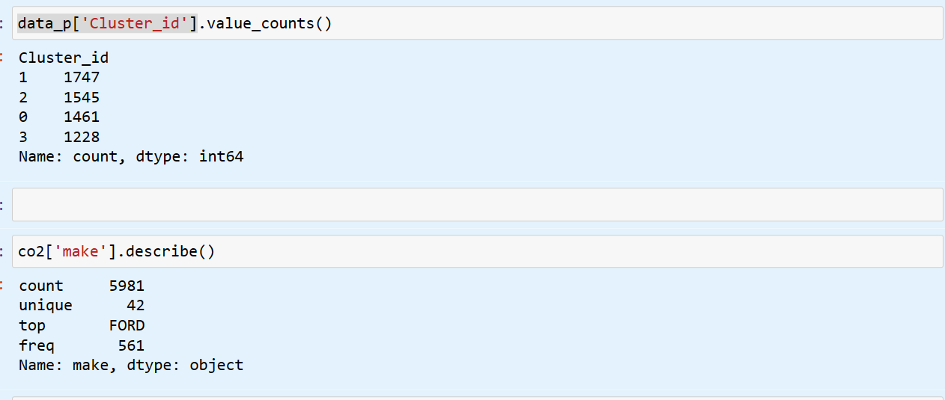
Value Counts Of Each Cluster

Slide 34
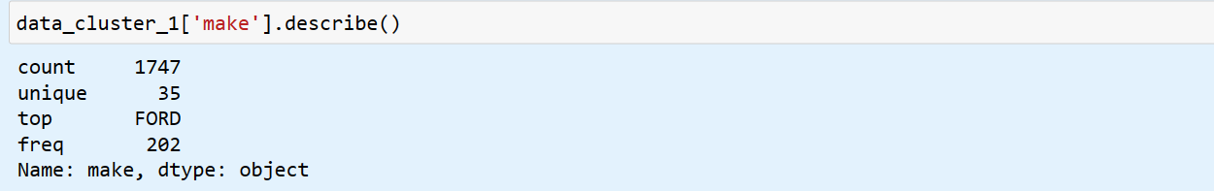
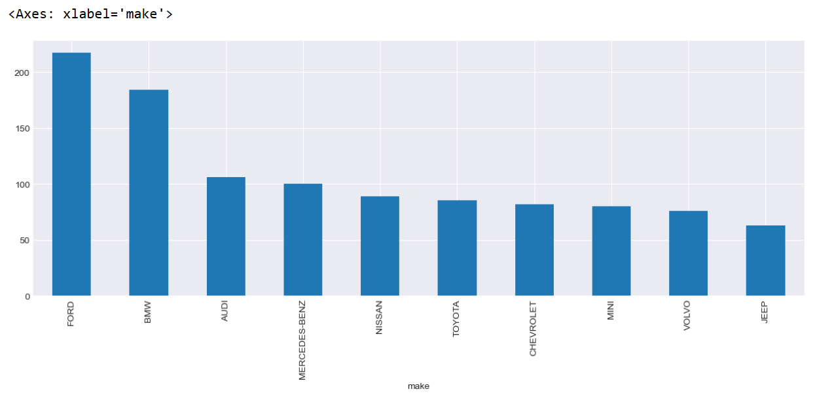
Top-10 makers from Cluster_1

Slide 35
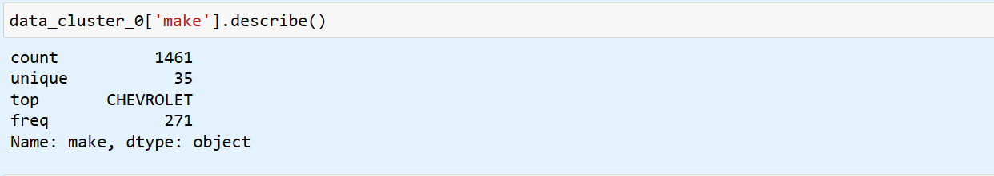
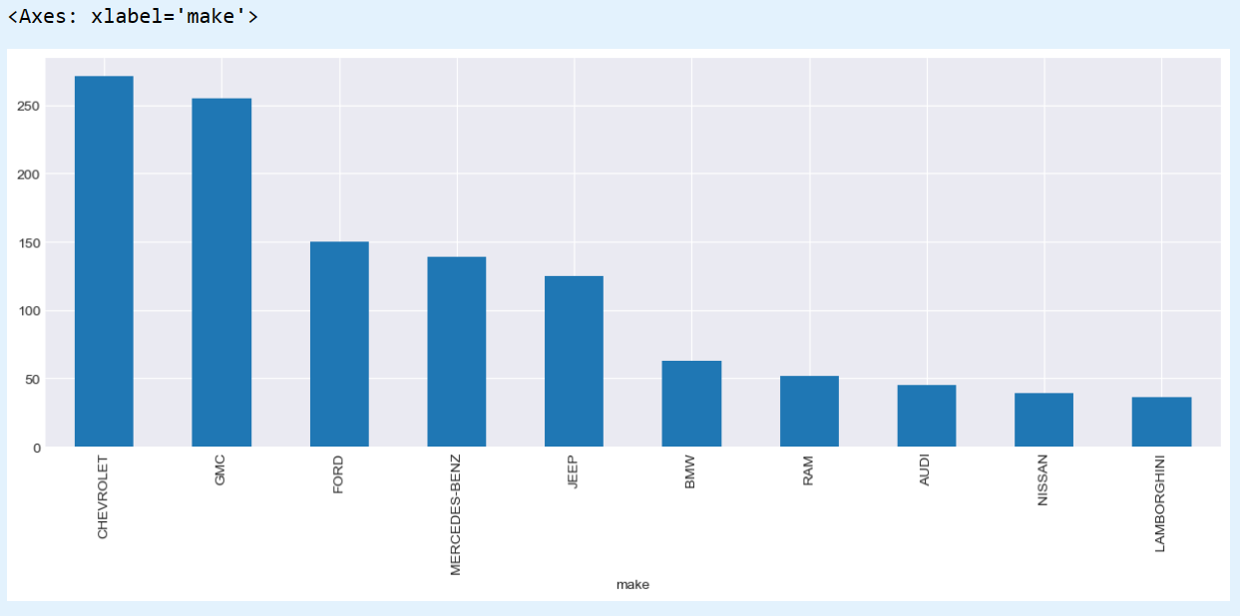
Top-10 makers from Cluster_0

Slide 36
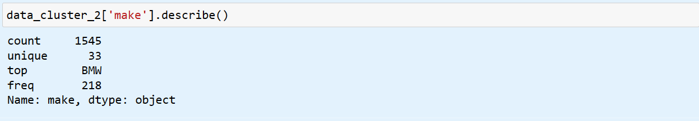
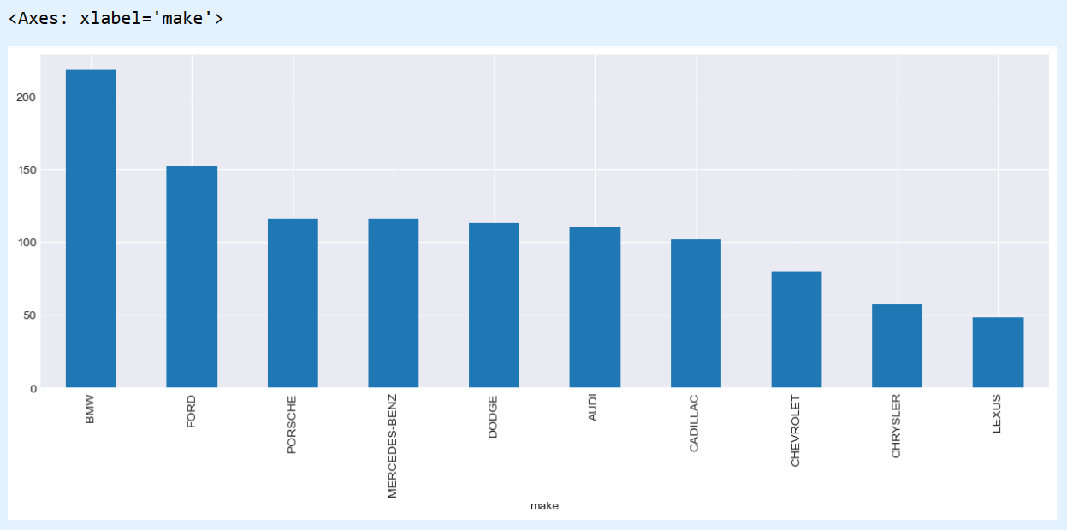
Top-10 makers from Cluster_2

Slide 37
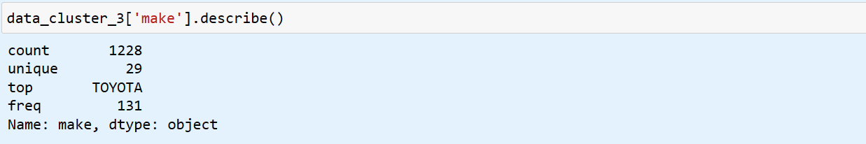
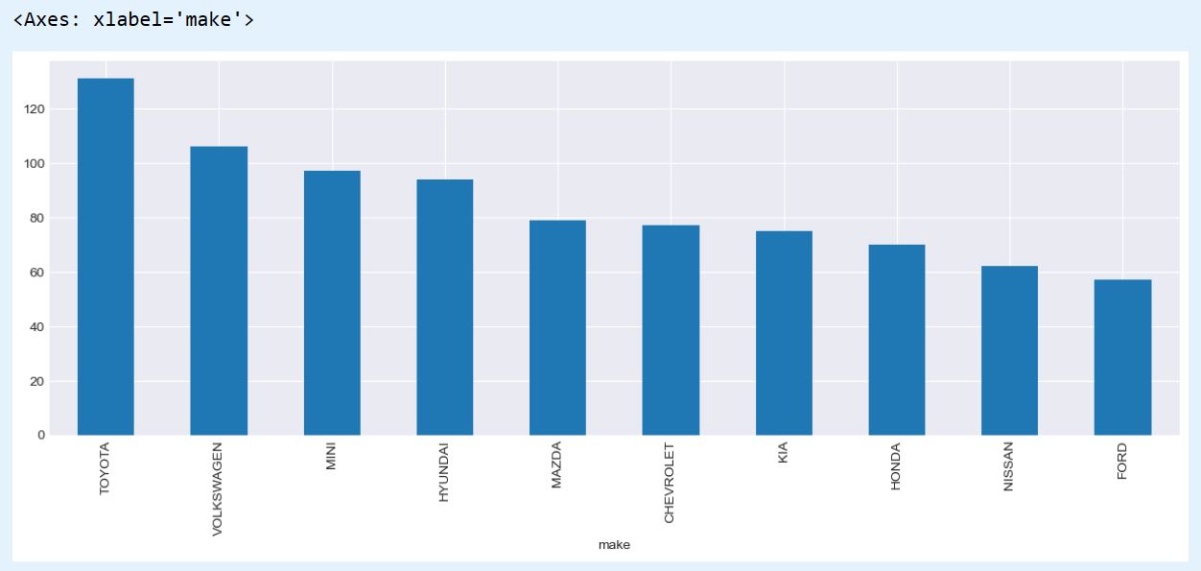
Top-10 makers from Cluster_3

Slide 38
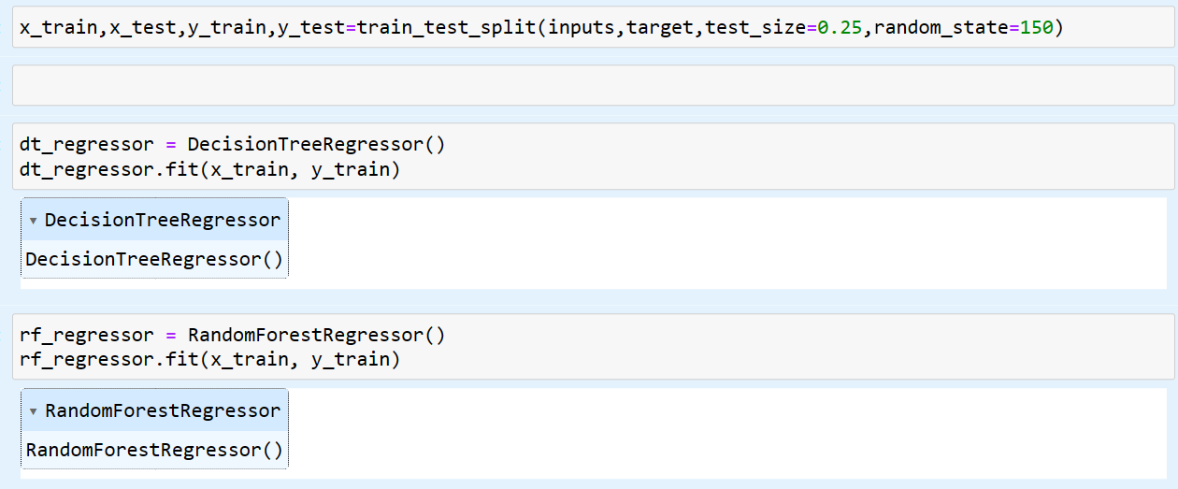
Model Building by using the train data

Slide 39
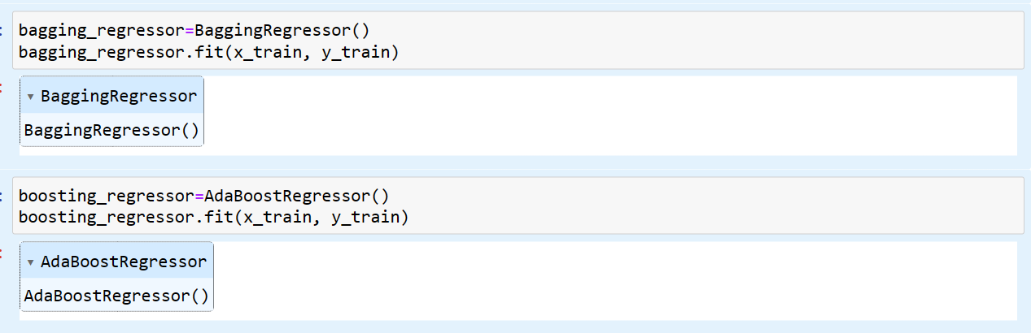
Fitting Trained Data into Bagging & Boosting

Slide 40
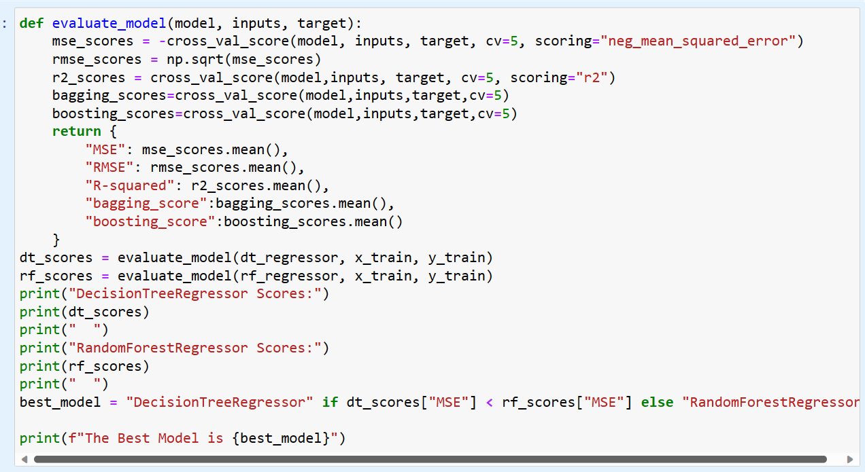
Finding & Comparing The Models Efficiency

Slide 41
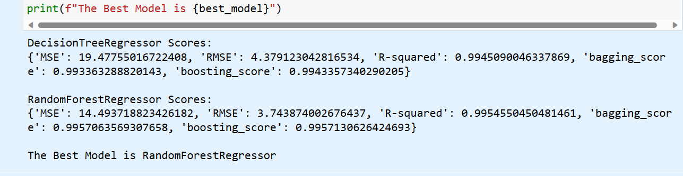
Found The Best Model

Slide 42
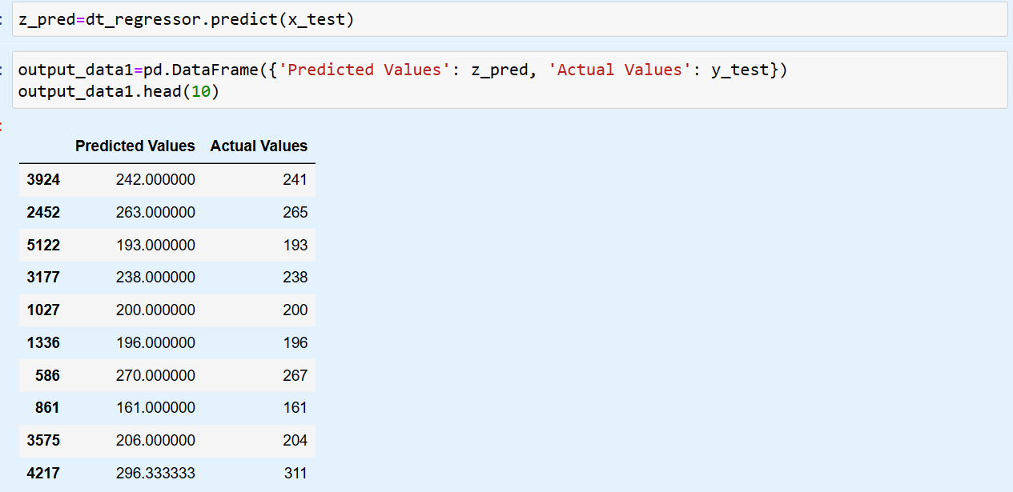
Comparing the Predicted Values with Actual

Slide 43
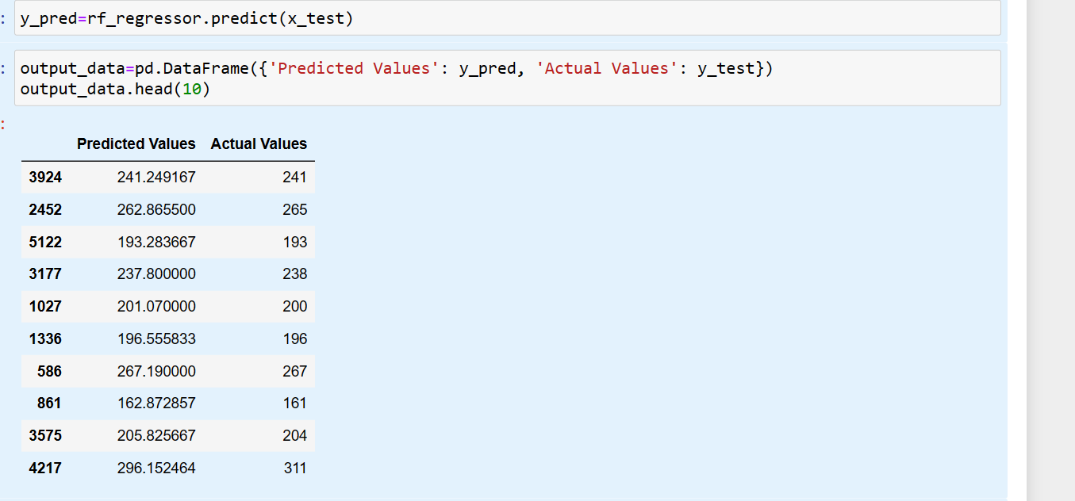
Comparing the Predicted Values with Actual

Slide 44
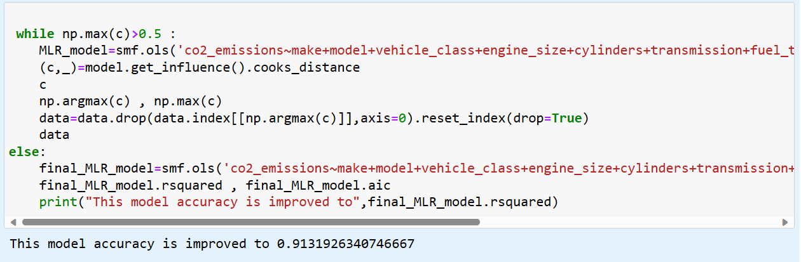
MLR Model

Slide 45
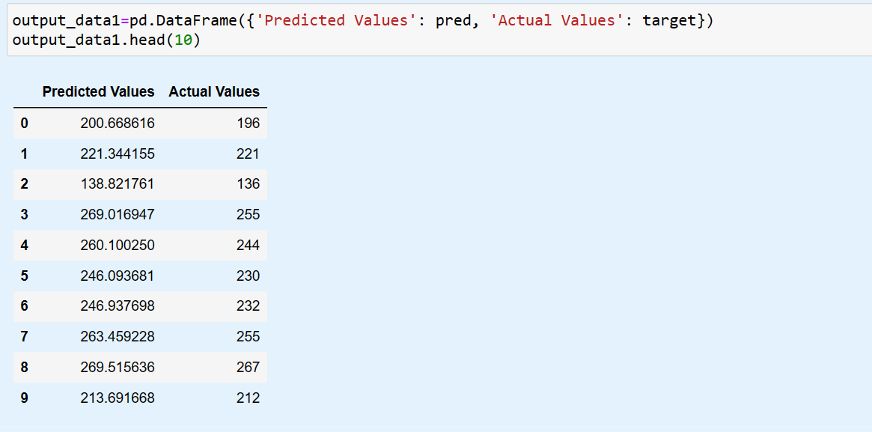
Comparing the Predicted Values with Actual

Slide 46
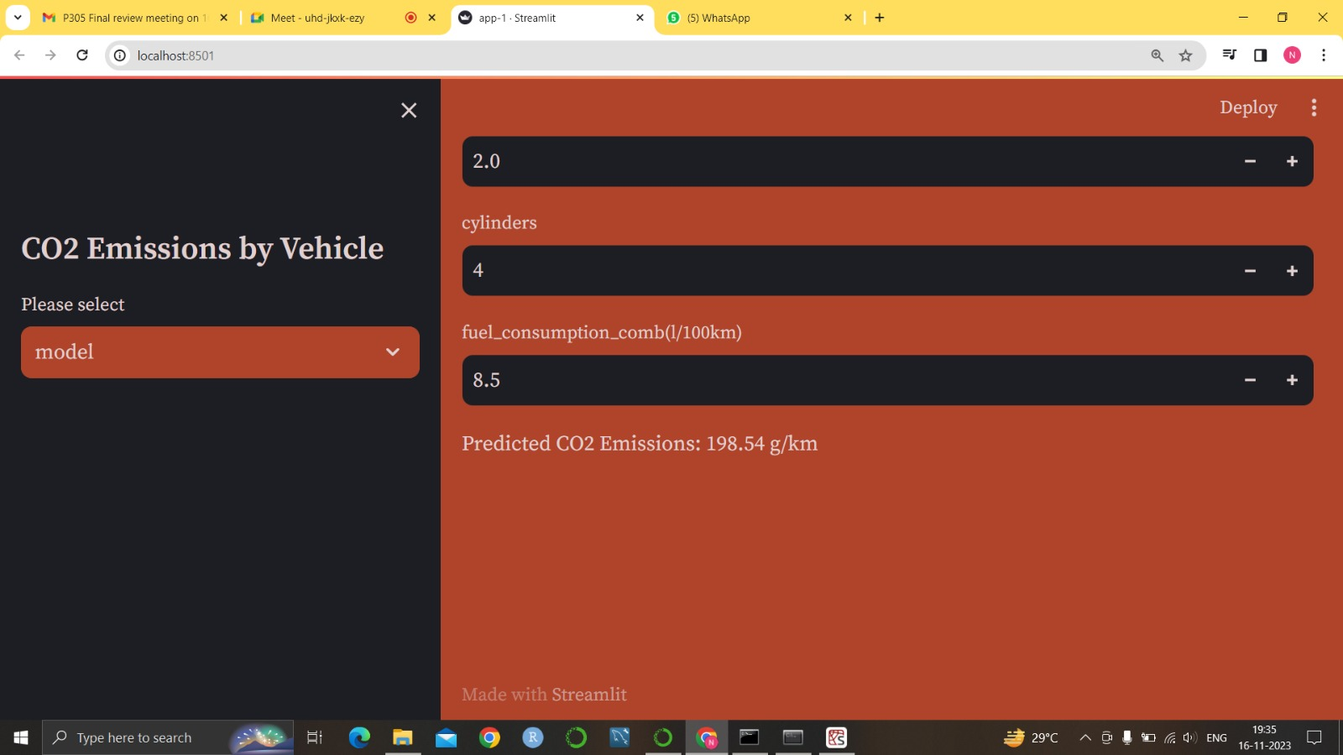
Deployment

Slide 47
THANK YOU

